Slide 1

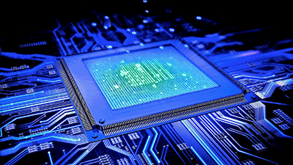
Introduction to Digital Systems
EGR 226
Lecture_8
Dr. Nabeeh Kandalaft EGR226 Grand valley State University

Slide 2
Topic for today’s lecture
describe the Serial Peripheral Bus (SPI)
the bus architecture
the protocol for messaging between master and slave
compare the SPI and I2C bus relative advantages
describe several types of low cost displays for embedded systems
describe the basic operation of a liquid crystal display (LCD)
describe the basic operation of a display controller IC
Dr. Nabeeh Kandalaft EGR226 Grand valley State University

Slide 3
Embedded system architecture
Processing And Control
Inputs
Outputs
Analog
Sensors
A/D
Converter
D/A
Converter
Analog
Actuators
Power
Supply
Display
Micro
Controller
Digital
Inputs
Digital
Actuators
Inter-process
Communication
Memory
Timers
Dr. Nabeeh Kandalaft EGR226 Grand Valley State University

Slide 4
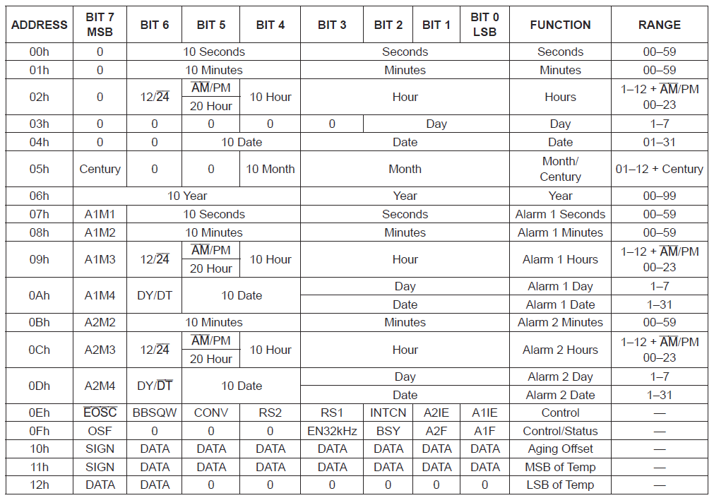
I²C Interface to Real Time Clock
From the data sheet for the DS3231

Slide 5
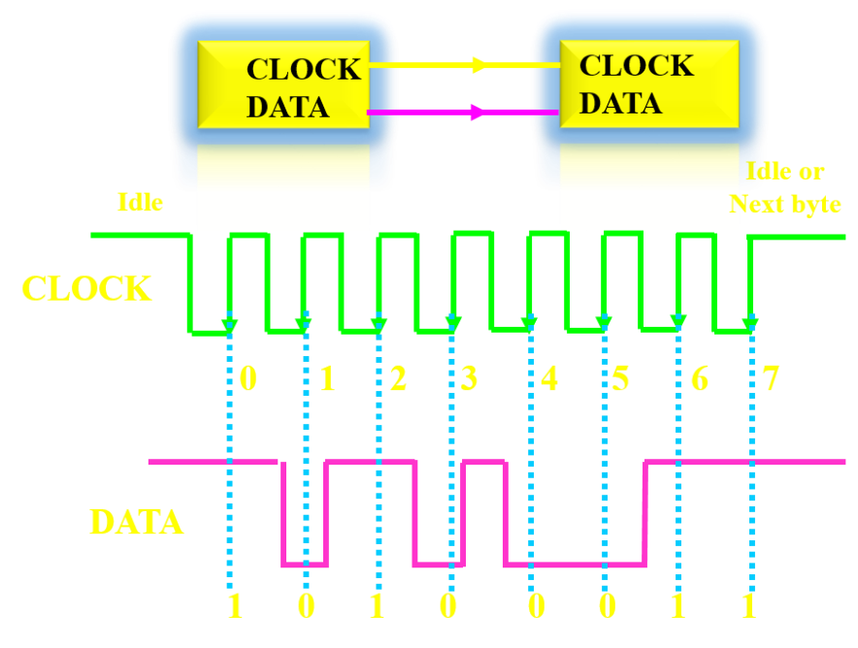
MORE Synchronous Serial Communication
INTRODUCING:
the Serial Peripheral Interface (SPI) bus.
Yup, still has a clock
still has data
One reason SPI is so popular is that the receiving hardware can be a simple shift register.

Slide 6
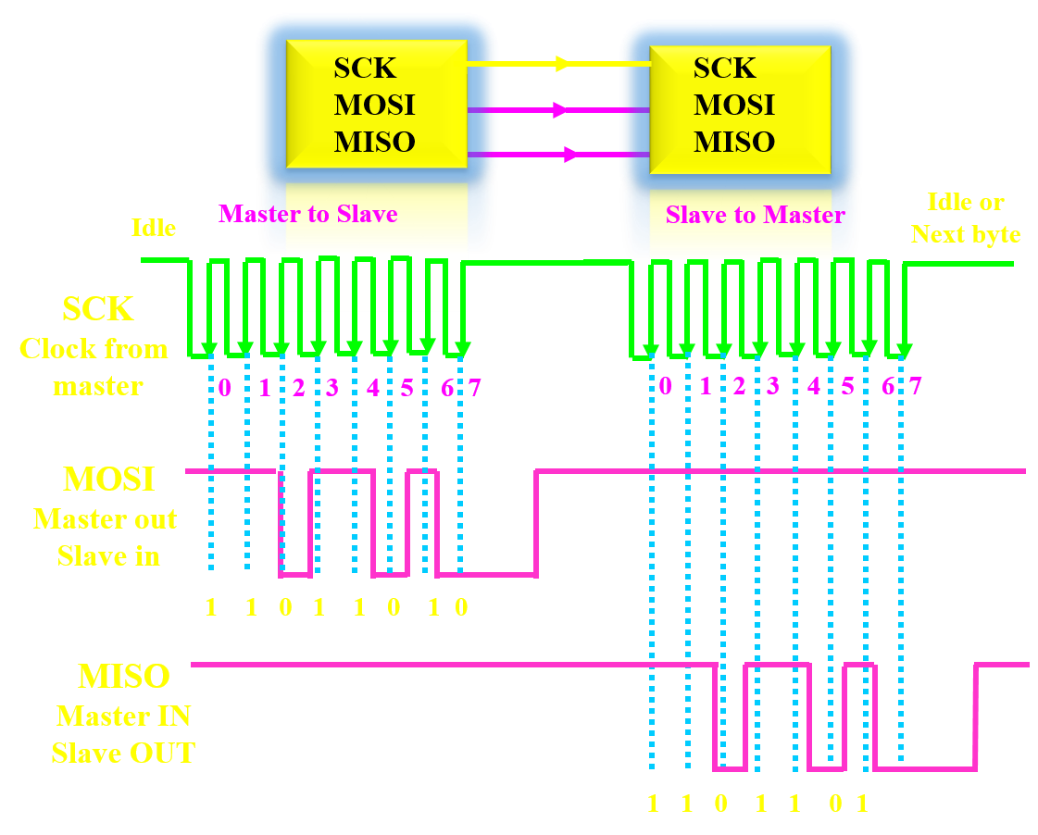
Communications - SPI
One side generates the clock signal called the “master” (only one)
The other side is called the “slave” (can be more than one).
Data is sent from the master to a slave on a data line,
MOSI, …..
Or “Master Out / Slave In”.
Data is sent from the slave to a master on another data line,
MISO……
for “Master In / Slave Out”.

Slide 7
Communications - SPI
If the slave needs to send a response back to the master, the master will continue to generate a prearranged number of clock cycles, and the slave will put the data onto the MISO line.
Since the master always generates the clock signal, it must know in advance when a slave needs to return data and how much data will be returned.
SPI is generally used to talk to sensors

Slide 8
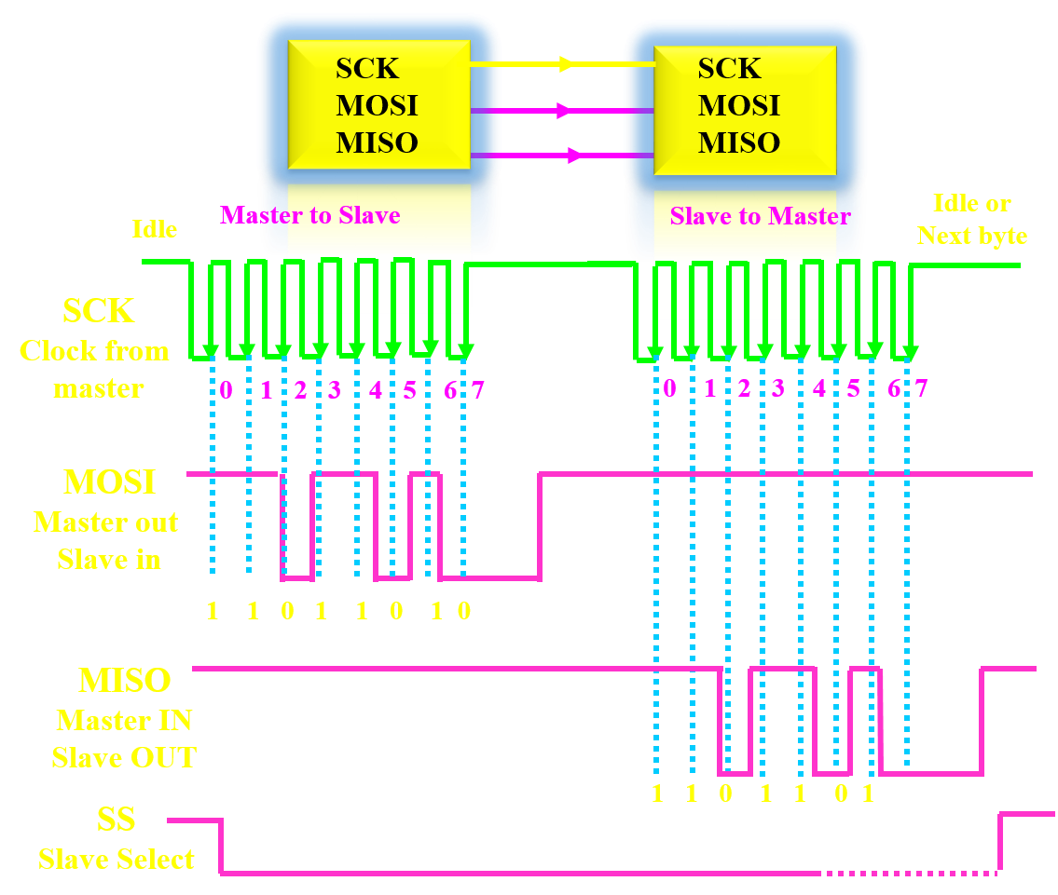
Communications - SPI
The last line is called SS for Slave Select.
This tells the slave that it should wake up and receive / send data
The SS line is normally held high, (deasserted)
Just before data is sent to the slave, the line is brought low, which activates the slave.

Slide 9
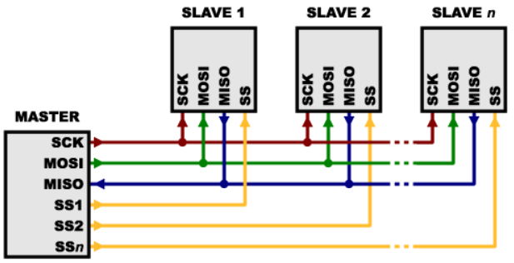
Communications - SPI
For multiple slaves, each slave will need a separate SS line.
To talk to a particular slave, you’ll make that slave’s SS line low and keep the rest of them high

Slide 10
Communications - SPI
For multiple slaves, each slave will need a separate SS line.
To talk to a particular slave, you’ll make that slave’s SS line low and keep the rest of them high

Slide 11
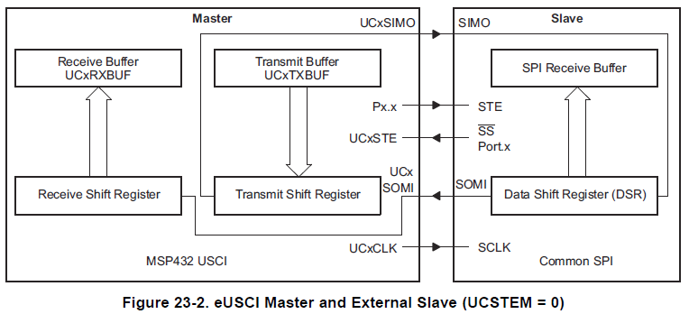
Basic SPI Master-Slave
Note: For single master operation, configure the system select as an output and initialize to logic HIGH, otherwise, if pulled low in the default (input) state, the SPI interface could interpret this signal as another master wishing to take over the bus
from TI MSP432P4XX Family Techncal Reference Guide

Slide 12
I2C and SPI Comparisons
On several key protocol aspects:
Bus topology / routing / resources:
I²C only needs 2 lines, while SPI defines at least 4 signals and more, if you add additional slaves.
If only one master/slave, SPI does not have the addressing overhead of I²C
SPI requires additional logic and/or pins for a multi-master architecture.
I²C is a clear winner over SPI in sparing pins and how easy it is to build a network of masters and slaves.

Slide 13
I2C and SPI Comparisons
On several key protocol aspects:
Throughput / Speed:
If data must be transferred at ‘high speed’, SPI is the protocol of choice, over I²C.
SPI is full-duplex; I²C is not.
SPI does not define any speed limit;
implementations can go over 10 Mbps.
I²C is limited to 1Mbps in Fast Mode+ and to 3.4 Mbps in High Speed Mode
high speed mode requires a specific type of I/O buffers making it a bit more difficult to implement.

Slide 14
I2C and SPI Comparisons
On several key protocol aspects:
Elegance:
I²C offers very advanced features – such as automatic multi-master conflicts handling and built-in addressing management
simple infrastructure, complex logic
SPI is easy to understand and to implement and offers a great deal of flexibility
Using SPI offers increased data transfer performance and freedom from restrictive protocol
Both SPI and I2C are good for communication with low-speed devices
SPI is better suited to applications with data transfer streams
I²C is better at multi master and multi slave applications.

Slide 15
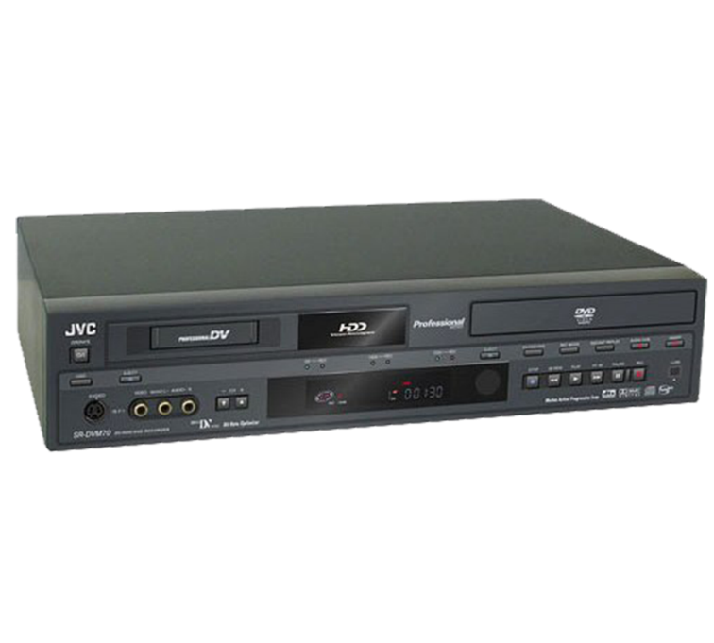
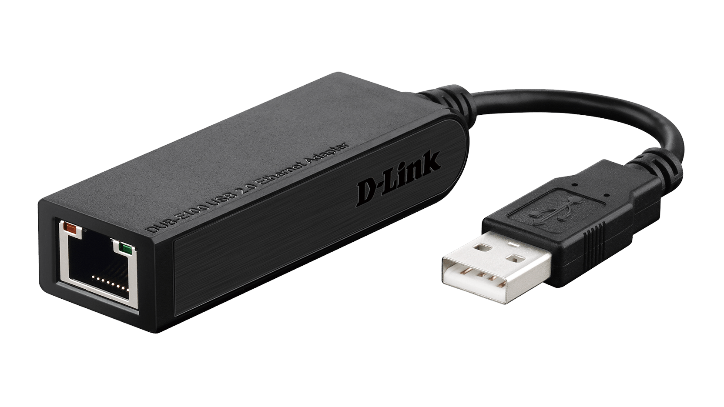
I2C and SPI Comparisons
On several key protocol aspects:
Both are offered by many vendors
EEPROM, ADC, DAC, RTC (Real-time clocks), microcontrollers, sensors, LCD controllers are available with I²C, SPI or both interfaces.
Communication between a microcontroller and a set of relatively slow peripherals does not need any excessively complex protocols (e.g., USB, Ethernet).
I²C and SPI are the popular choice for an embedded system
BETAMAX TO HD-DVD CONVERTOR

Slide 16
Embedded Systems Displays
What are some low-cost displays for embedded systems?

Slide 17
Embedded Systems Displays
What are some low cost displays for embedded systems?
led
tri-color led
seven segment display LED/LCD
two line LCD
graphic matrix LCD
NOT: holographic video displays
Haptic displays

Slide 18


Embedded Systems Displays
seven segment display LED
Driving 7-Segment Display using 4511
+15V
Common Cathode
Display
8x220Ω
+5V
4511
BCD to
7-Segment
Decoder
A
B
C
D
a
f
b
g
e
4 bit Binary
Coded Decimal
Input
c
d
Dr. Nabeeh Kandalaft EGR226 Grand valley State University

Slide 19
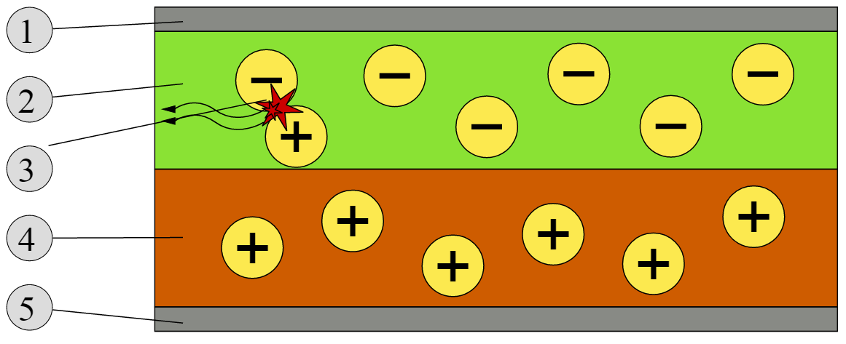
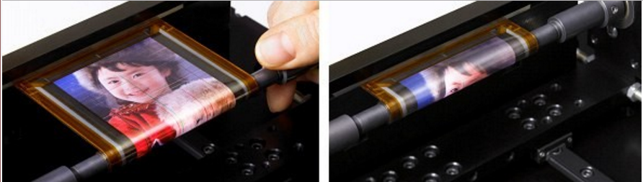
Embedded Systems Displays
Organic LED (OLED)
Active-matrix OLEDs require a thin-film transistor backplane to switch each individual pixel on or off
Flexible screen prototype by Sony
Bilayer OLED Schematic
1. Cathode (−)
2. Emissive Layer
3. Emission of radiation
4. Conductive Layer
5. Anode (+)
By nDevilTV (http://www.flickr.com/photos/ndevil/4641264649/) [CC BY 2.0 (http://creativecommons.org/licenses/by/2.0)]

Slide 20
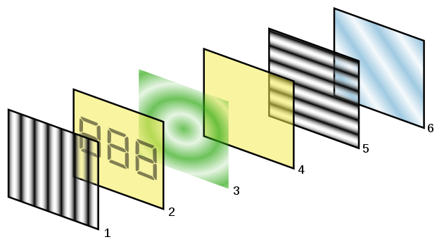
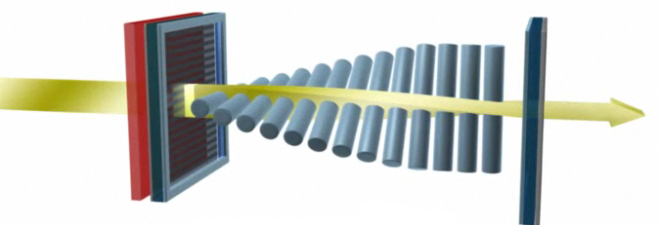

LCD Operation
A liquid-crystal display (LCD) uses the light modulating properties of liquid crystals. Liquid crystals do not emit light directly.
Polarizing filters at 90 block light rays
Twisted nematic liquid crystal between 2 electrodes
https://www.youtube.com/watch?v=0B79dGR19Tg
Dr. Nabeeh Kandalaft EGR226 Grand valley State University
Notes:
LCDs or Liquid Crystal Displays are a major part of technology. They can be found almost everywhere – watches, calculators, mobile phones, laptops, televisions, cars and many more. Obviously, LCD display on a calculator is different than an LCD TV, but the fact is that they all work on a same basic principle. An LCD screen basically consists of liquid crystal solution sandwiched between two transparent electrodes and two polarizing filter sheets. Following is the basic working principle of a Liquid Crystal Display.
Working of LCD Image source: Wikimedia Commons
The image at right shows the various layers of a typical LCD screen.
Vertical polarization filter film
Glass substrate with Idiom-Tin-Oxide (ITO) electrodes. ITO is a transparent and conducting oxide. Verticle ridges (or grooves) are etched on the side that does not have polarization film so that the liquid crystals align in line with the polarized light.
Layer of twisted nematic liquid crystals.
Glass substrate with common ITO electrode film with horizontal ridges to line up with polarizing filter.
Horizontal polarization film.
Reflective surface (mirror).
As light strikes the first layer of the vertical polarizer, it gets polarized. Because of the ridges on the glass substrate electrodes, the nematic liquid crystals are aligned with the vertical polarization plane. The liquid crystals layer is twisted and the molecules at the far side are aligned with the polarization plane of the horizontal polarization film. As the initially vertically polarized light passes through this twisted liquid crystals layer, angle of the plane of polarization also changes to match the angle of the molecules of the liquid crystals. When the light reaches the far side of the liquid crystals layer, the plane of polarization becomes horizontal and it passes through the polarized film. Thus, the light also passes back through all the layers after reflecting from the mirror.
When an electric charge is applied to the liquid crystals through the electrodes, they untwist. As the molecules straighten out, their alignment no more matches the plane of polarization or the farthest film. Consequently, the light gets blocked at the areas where electric charge is applied.

Slide 21

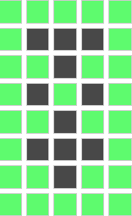
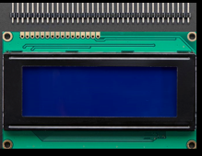
The HD44780 LCD Display
LCD uses a small dot matrix to display a limited amount of information at low cost.
A representative HD44780 compatible (standard controller chip) LCD display,
16 character 4 line display
Bit 4
Bit 3
Bit 2
Bit 1
Bit 0
Byte 0
Byte 1
Byte 2
Byte 3
Byte 4
Byte 5
Byte 6
Byte 7
byte customChar[8] = {
0b00000,
0b01110,
0b00100,
0b01010,
0b00100,
0b01110,
0b00100,
0b00000 };
Draws characters using rows and columns of small dots that can be turned ON and OFF to form a single character.
A 5x8 dot display would draw each character with 5 columns and 8 rows of dots, each character requires the control of 40 dots.
Dr. Nabeeh Kandalaft EGR226 Grand valley State University

Slide 22
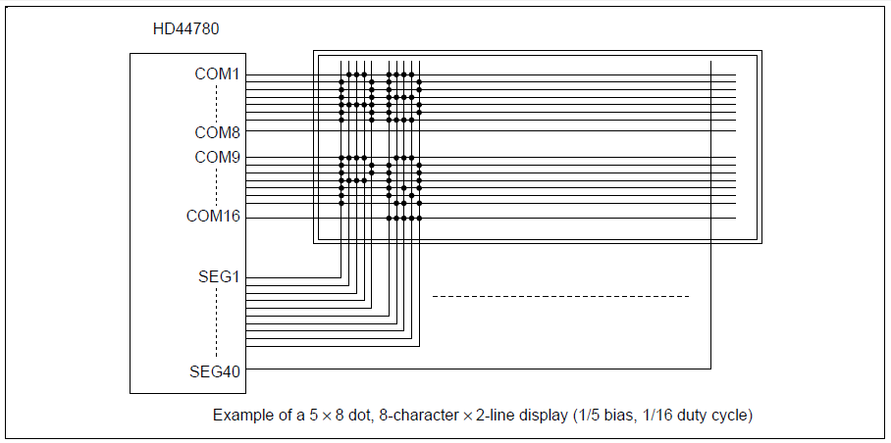
The HD44780 LCD Display
E.g., for 16 characters per line on 2 lines, there are a total of 1280 dots
Unrealistic to bring out separate control lines for each dot for connection to a microcontroller
A controller IC that takes care of turning ON and OFF all 1280 dots and presents a much simpler interface
Dr. Nabeeh Kandalaft EGR226 Grand valley State University

Slide 23
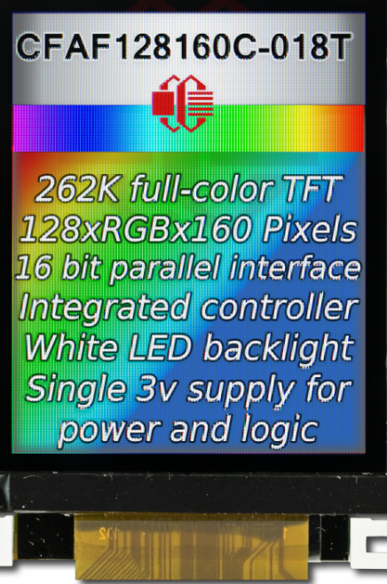
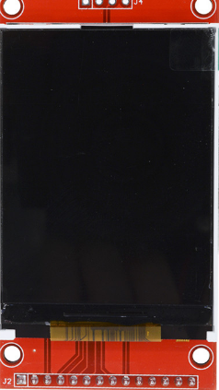
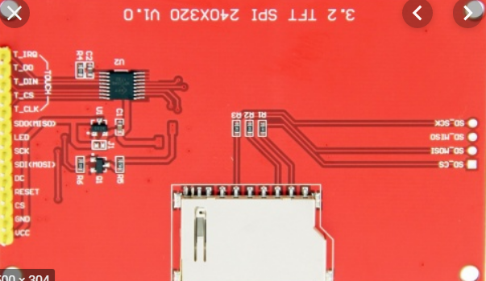
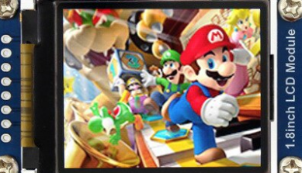
The ST7735R Graphics Display
LCD is 160 pixels by 128 pixels
TFT 18-bit color (262,144 shades)
with SD card on board

Slide 24
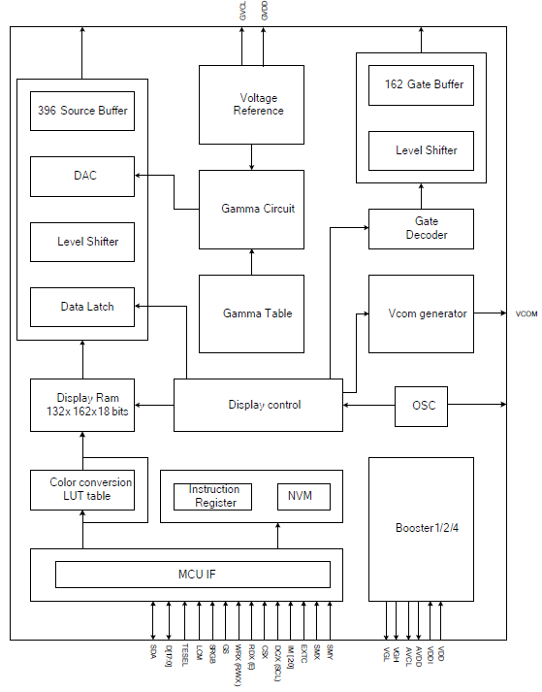
The ST7735R TFT LCD Controller/Driver
MCU interface
SPI (clock, data, CS)
Data/Command Line
Charge pump (for LCD control voltages)
Display RAM
Row and Column Drivers
RGB pixel intensity
From: ST7735R single-chip controller/driver data sheet

Slide 25
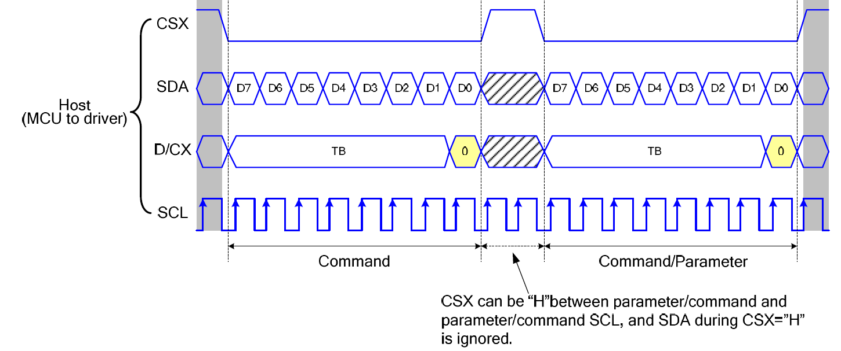
The ST7735R TFT LCD Controller/Driver
From: ST7735R single-chip controller/driver data sheet

Slide 26
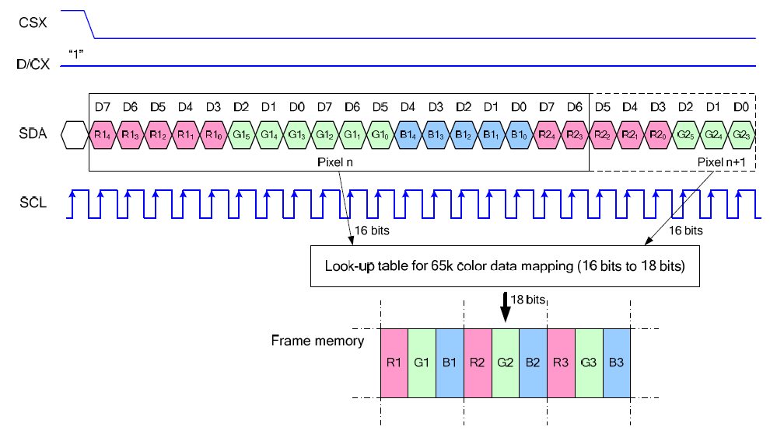
The ST7735R TFT LCD Controller/Driver
Write data for 16-bit/pixel (RGB 5-6-5-bit input), 65K-Colors
From: ST7735R single-chip controller/driver data sheet

Slide 27
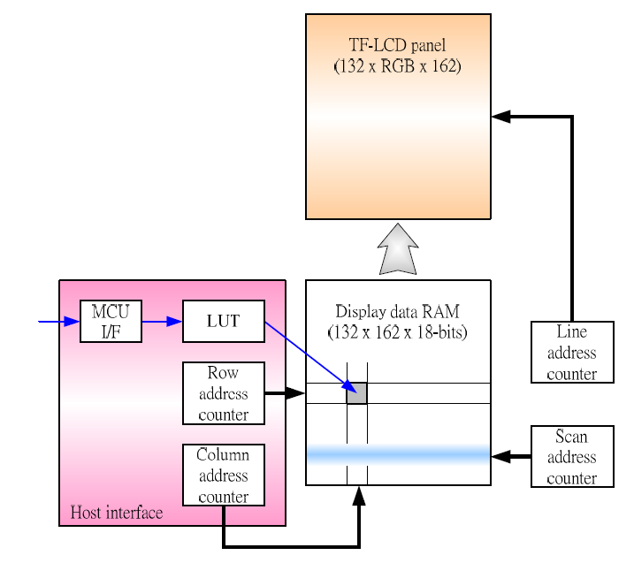
The ST7735R TFT LCD Controller/Driver
From: ST7735R single-chip controller/driver data sheet
Notes:
Look up table

Slide 28
SCK
MOSI
MISO
SCK
MOSI
MISO
Master to Slave
Slave to Master
Idle or
Next byte
Idle
SCK
Clock from
master
0 1 2 3 4 5 6 7
0 1 2 3 4 5 6 7
MOSI
Master out
Slave in
1 1 0 1 1 0 1 0
MISO
Master IN
Slave OUT
1 1 0 1 1 0 1
SS
Slave Select

